Slide 1

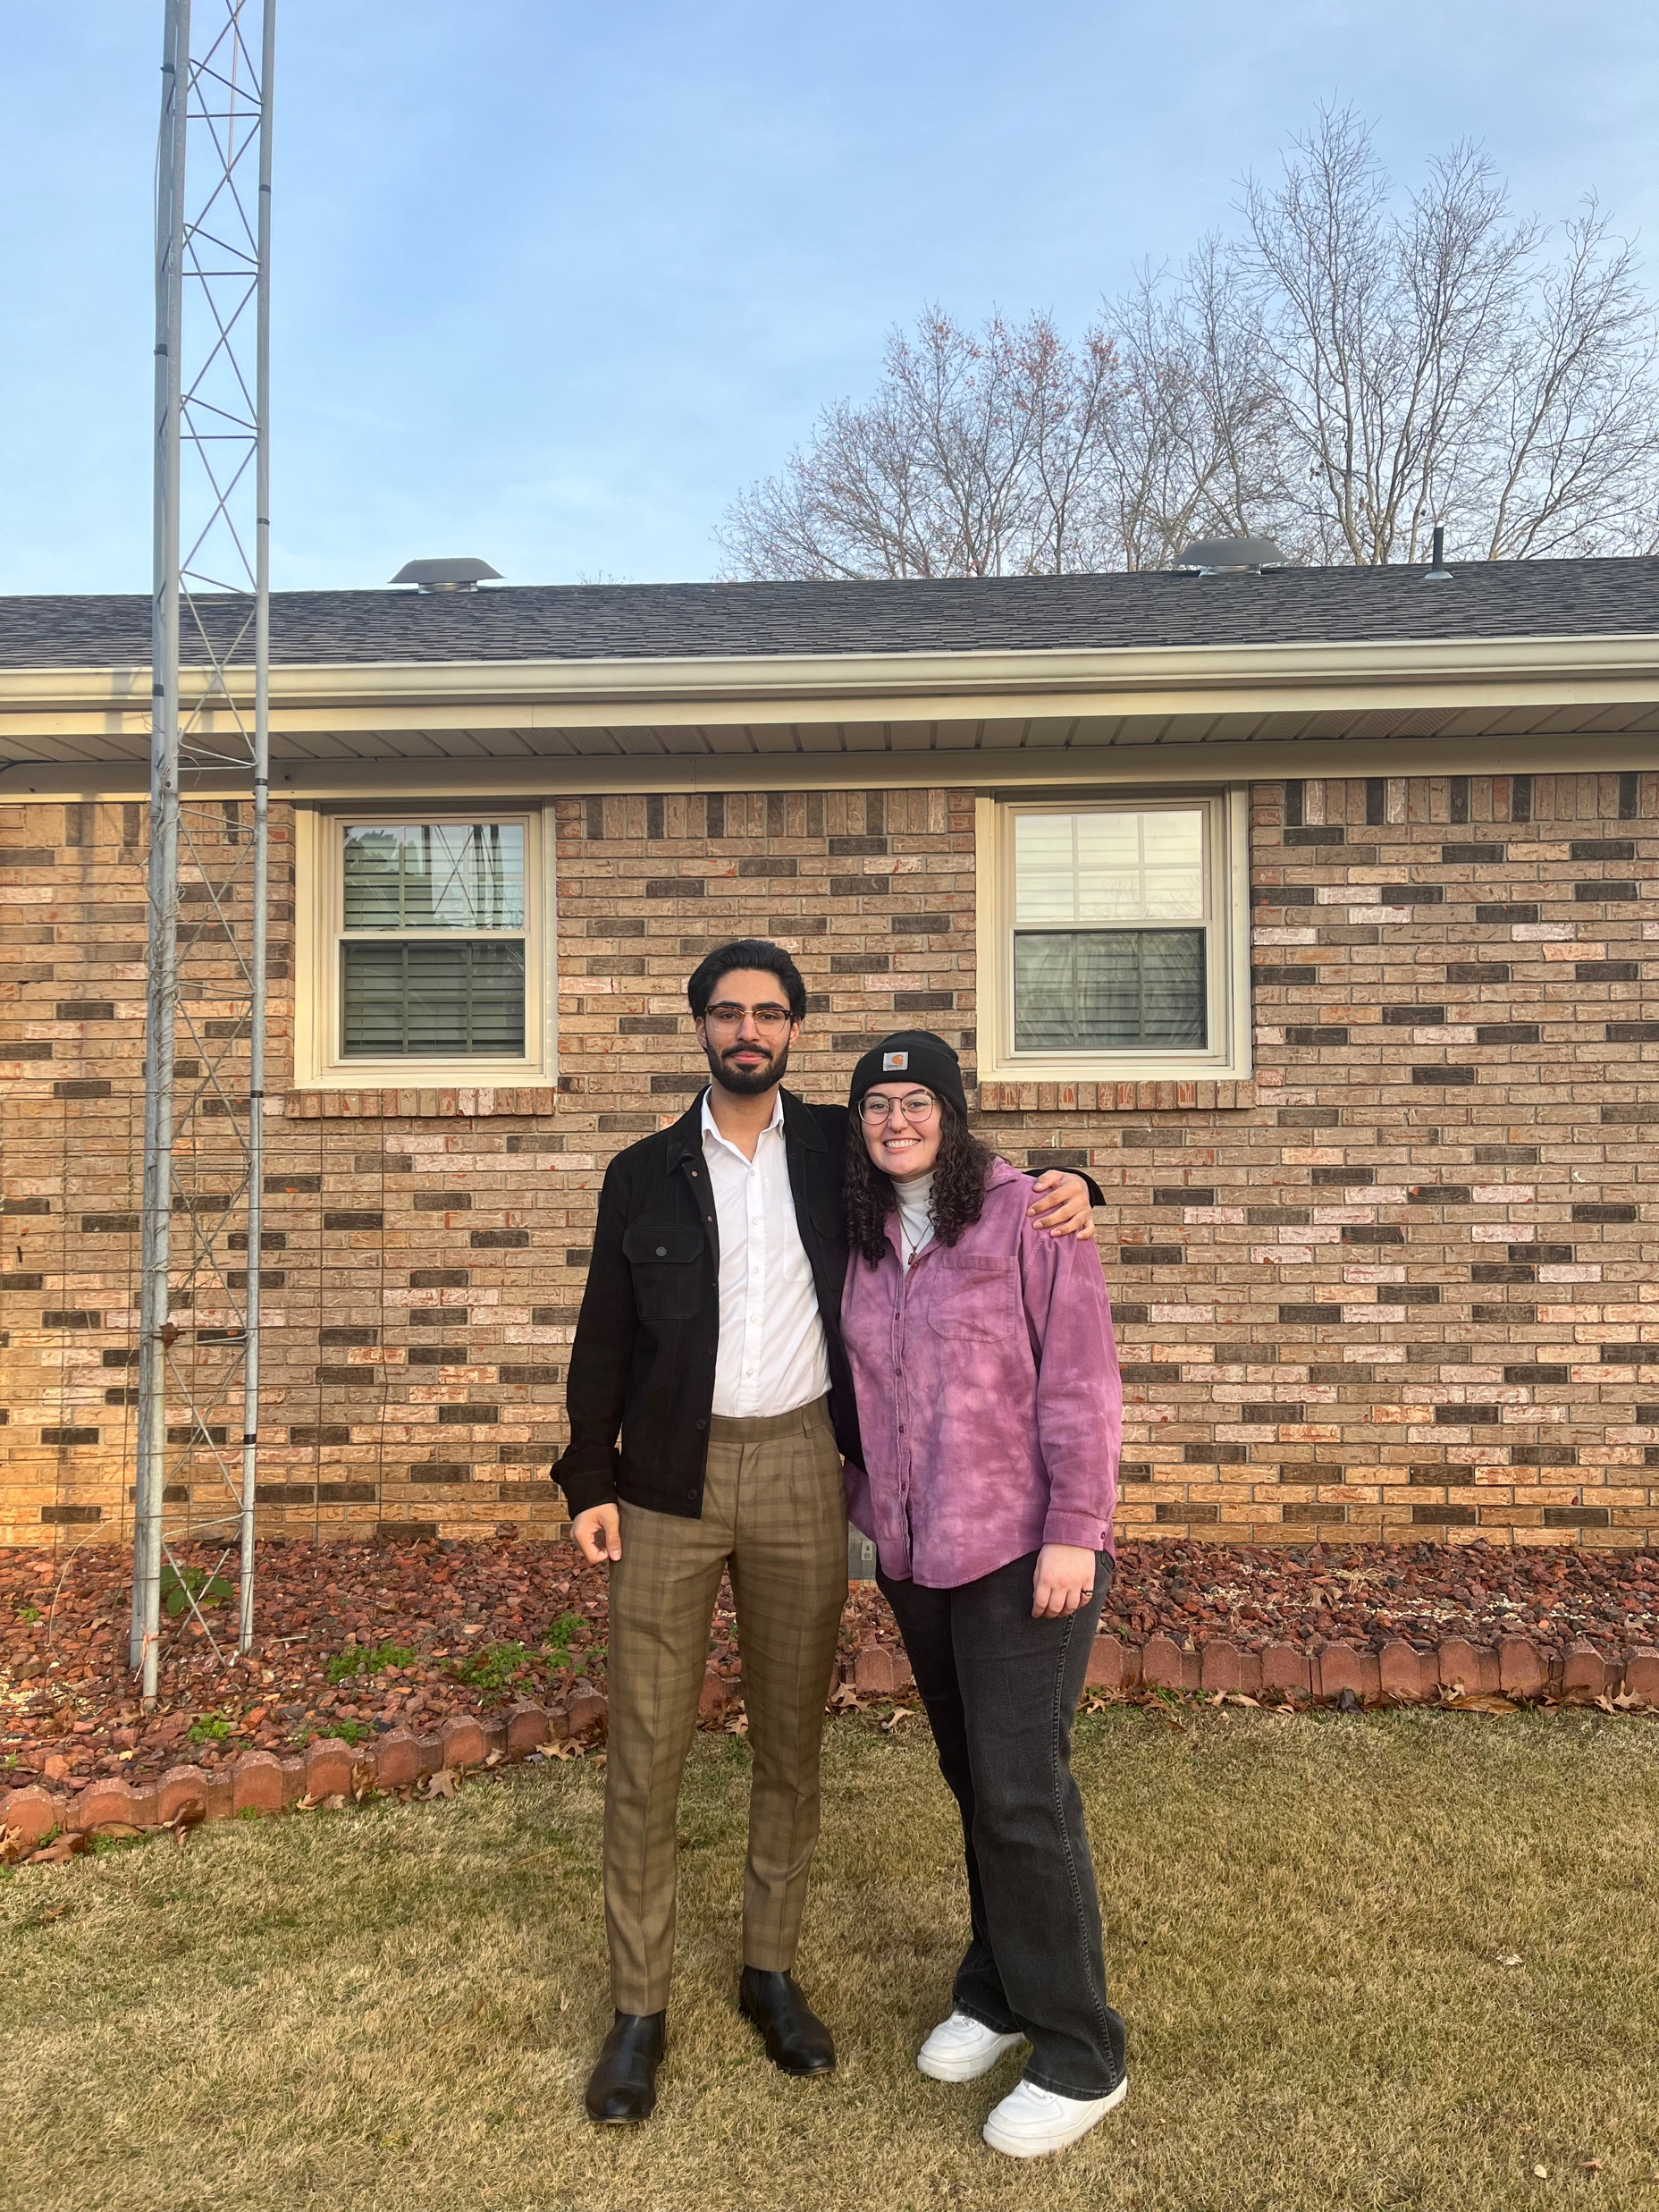
By Agampaul Singh & Sarah Grossheim
Final Project

Slide 2
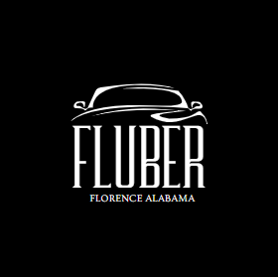
We proudly present to you...

Slide 3
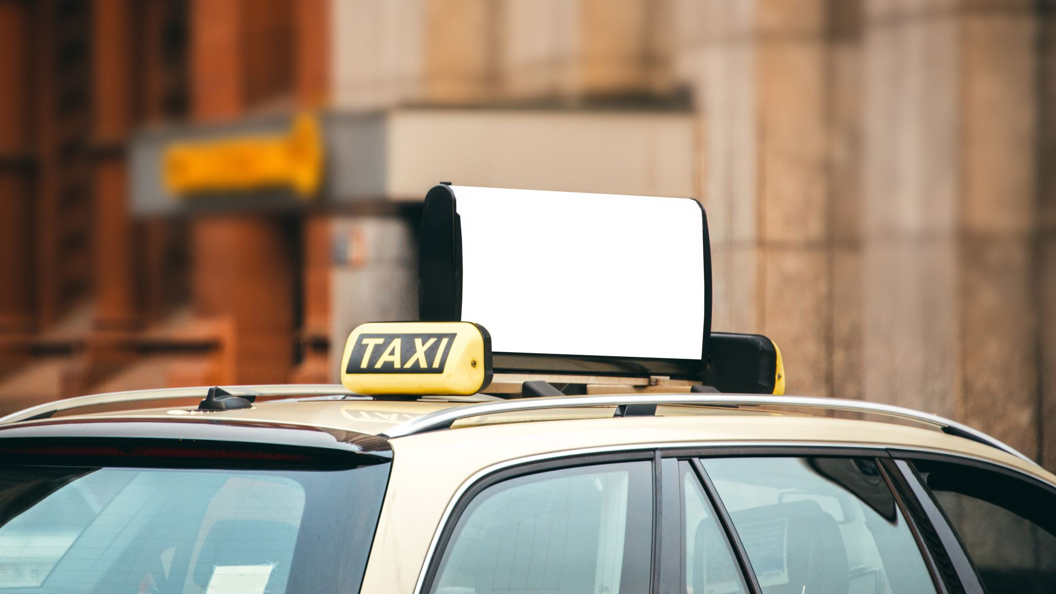
What is Fluber?
Fluber is Florence Alabama's very own uber service!
UNA STUDENTS ONLY!!!

Slide 4
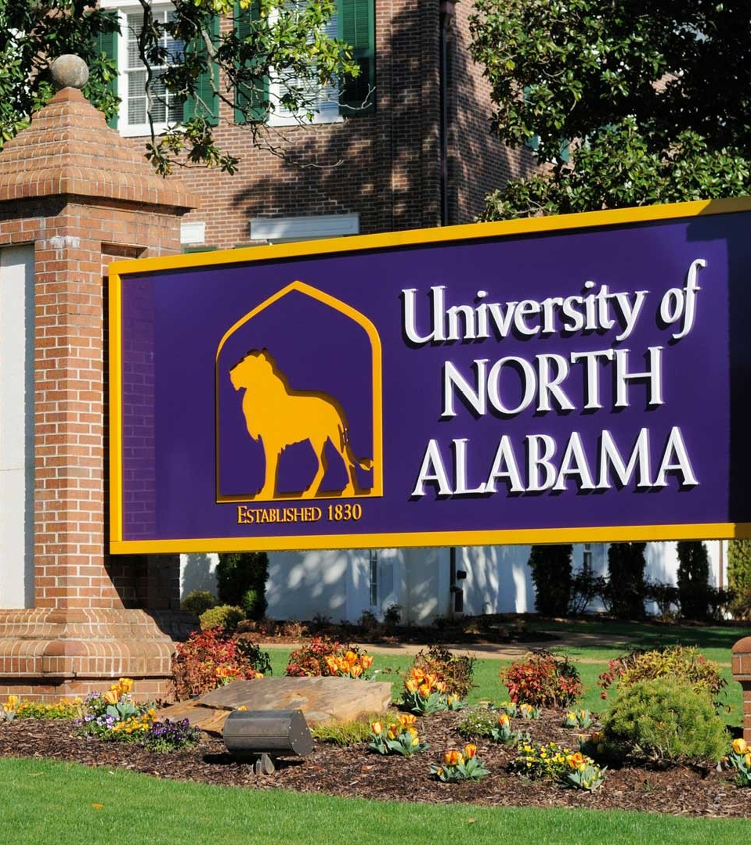
Fluber is your friend.
As a student at the University of North Alabama, you will need access to specific amenities on a daily basis.
These include things like:
Restaurants
Gyms
Libraries
Grocery Stores
Entertainment
Health Services

Slide 5
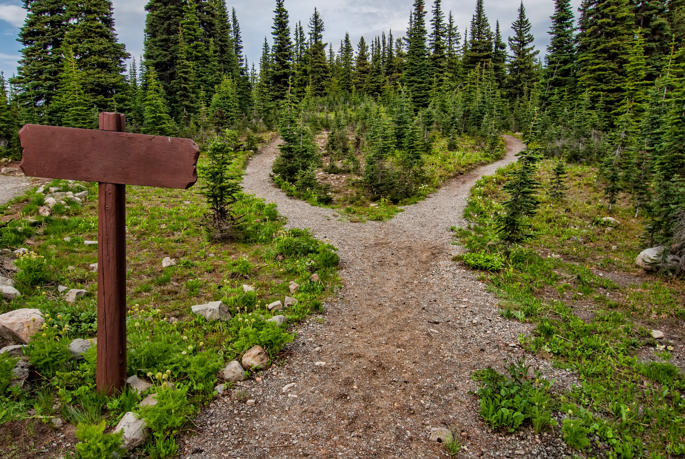
How does it work?
The purpose Fluber is to find the shortest path that gets students where they need to go!

Slide 6
Fluber will get you to any of these places as fast as possible!
Restaurants
Mcdonald's
Zaxby's
Cookout
Entertainment
Lauderdale Lanes
AMC Theaters
Skate Center
Grocery Stores
Walmart
Target
Aldi's
Gyms
Planet Fitness
Workout Anytime
Crunch Fitness
Health Services
North Alabama Medical Center
UNA Health Services
Libraries
Collier Library
Florence Public Library

Slide 7
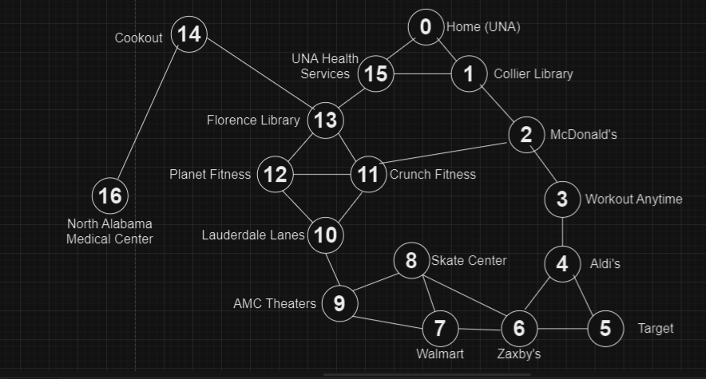
Fluber's Route

Slide 8

Coming up next is one student's three-day schedule that helps test out the functionality of Fluber's code.

Slide 9
Test plan for Sunday
First, I wake up and knock out an early morning workout at Planet Fitness. Distance = 3
The only snack I like to eat is pork rind cereal, but I ran out this morning. So now I must go grocery shopping. Head to Aldi's! Distance = 4
Since I had to buy milk for my Porkio's, I must now take my groceries home. Distance = 4
I have a test tomorrow, so I will go to the Collier Library to have a study sesh. Distance = 1
My roommate is hungry, and they invited me to go out to eat. Head to Zaxby's. Distance = 4
Finally, go back home for a good night's sleep. Distance = 5

Slide 10
Test plan for Monday
First, I wake up and go to the Florence Public Library to study for my test. Distance = 2
Then, I go back home (to UNA), to take my test. Distance = 2
I wasn't feeling well during my test, so after, I visited UNA Health Services. Distance = 1
Uh oh, it is worse than I expected. I must go to the hospital. Go to North Alabama Medical Center. Distance = 3
Turns out I got food poisoning last night from Zaxby's. Go to Walmart to pick up my prescription. Distance = 6
Go back home to rest for the rest of the day. Distance = 6

Slide 11
Test plan for Tuesday
I woke up this morning and my classes for today were cancelled. Let's have some fun today! Head to Lauderdale Lanes for a game of bowling! Distance = 4
I wanted to continue the physical activity, so I went to Workout Anytime to break a sweat. Distance = 3
After all that physical activity, I was craving a corn dog. Go to Cookout! Distance = 4
I have been wanting to see the new Hunger Games movie, so go to AMC theaters. Distance = 4
My girlfriend just got out of class and wants me to take her on a date. Go to Target to surprise her with a gift. Distance = 3
I met up with her (she loved her gift), now take her skating at the Skate Center. Distance = 2
Take her out to eat but only let her order off the dollar menu at Mcdonald's. Distance = 4
You are pooped. It is time to go home. Distance = 2

Slide 12

So... How did we do that?

Slide 13
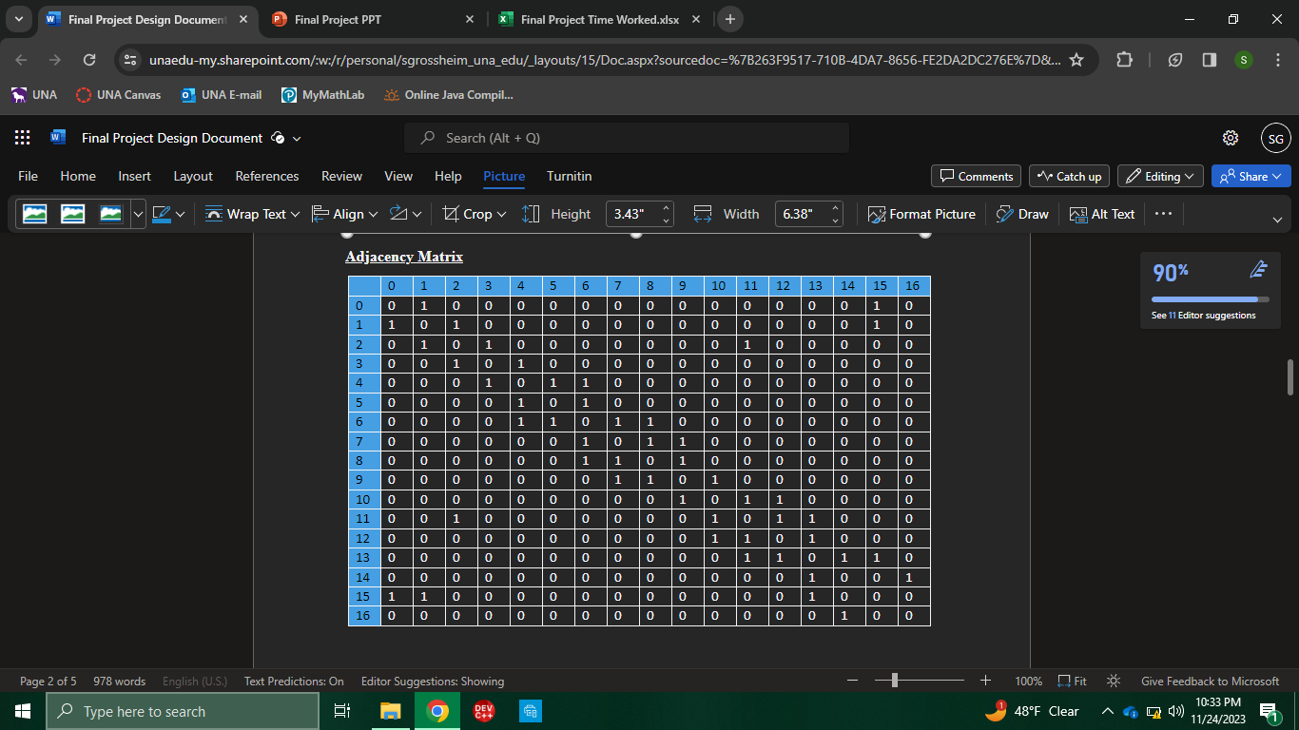
Adjacency Matrix
To implement Fluber's code, we imported a .txt file with this adjacency matrix of our map:

Slide 14
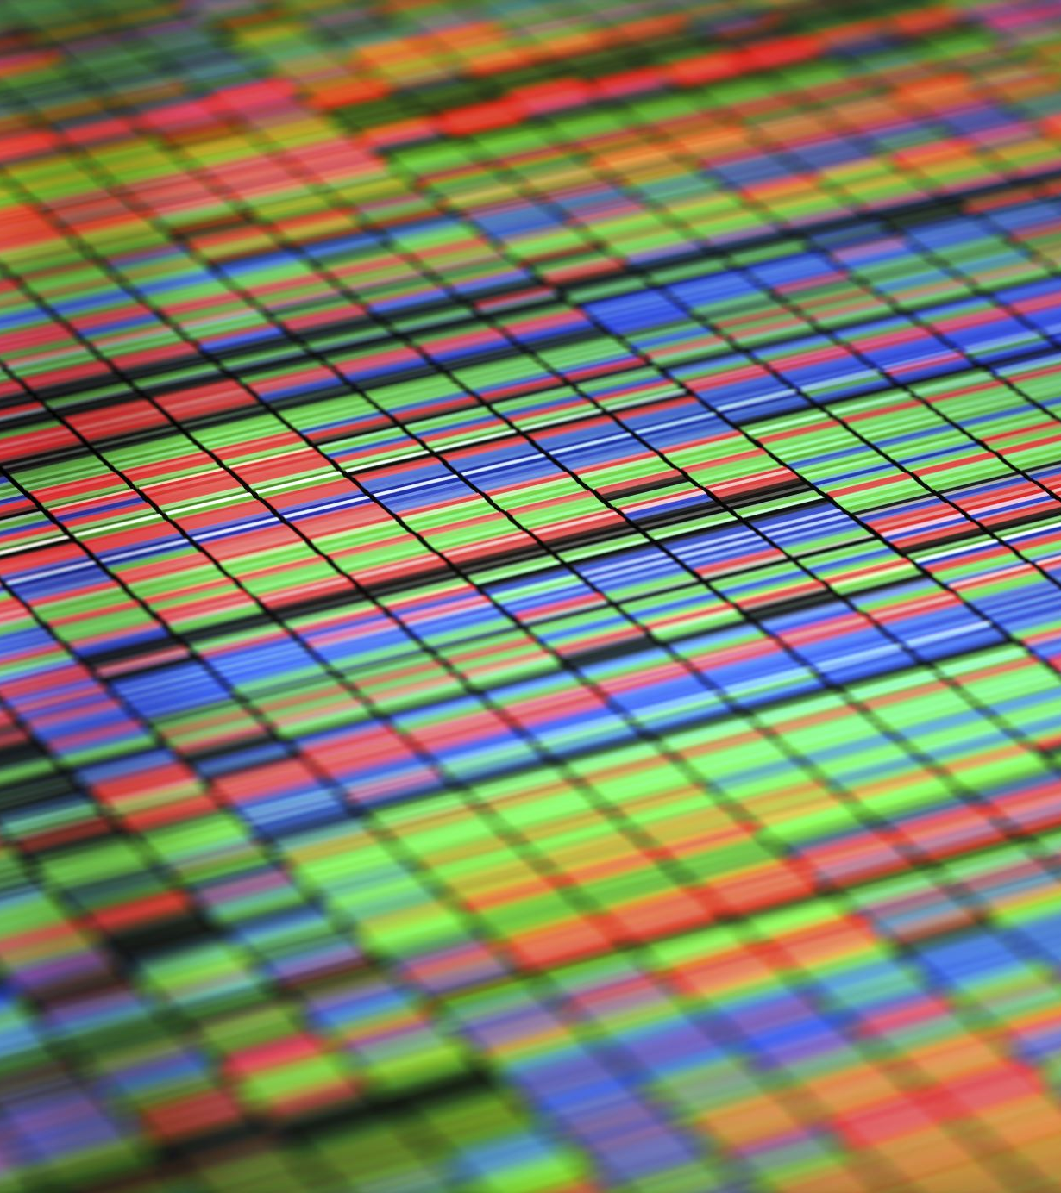
Algorithm Used: Djikstra's Algorithm
To implement the code for the shortest path problem, we used Djikstra's algorithm.
This algorithm will be explained in the code.

Slide 15

Since you have seen how we implemented it, let's take a look at the code.

Slide 16
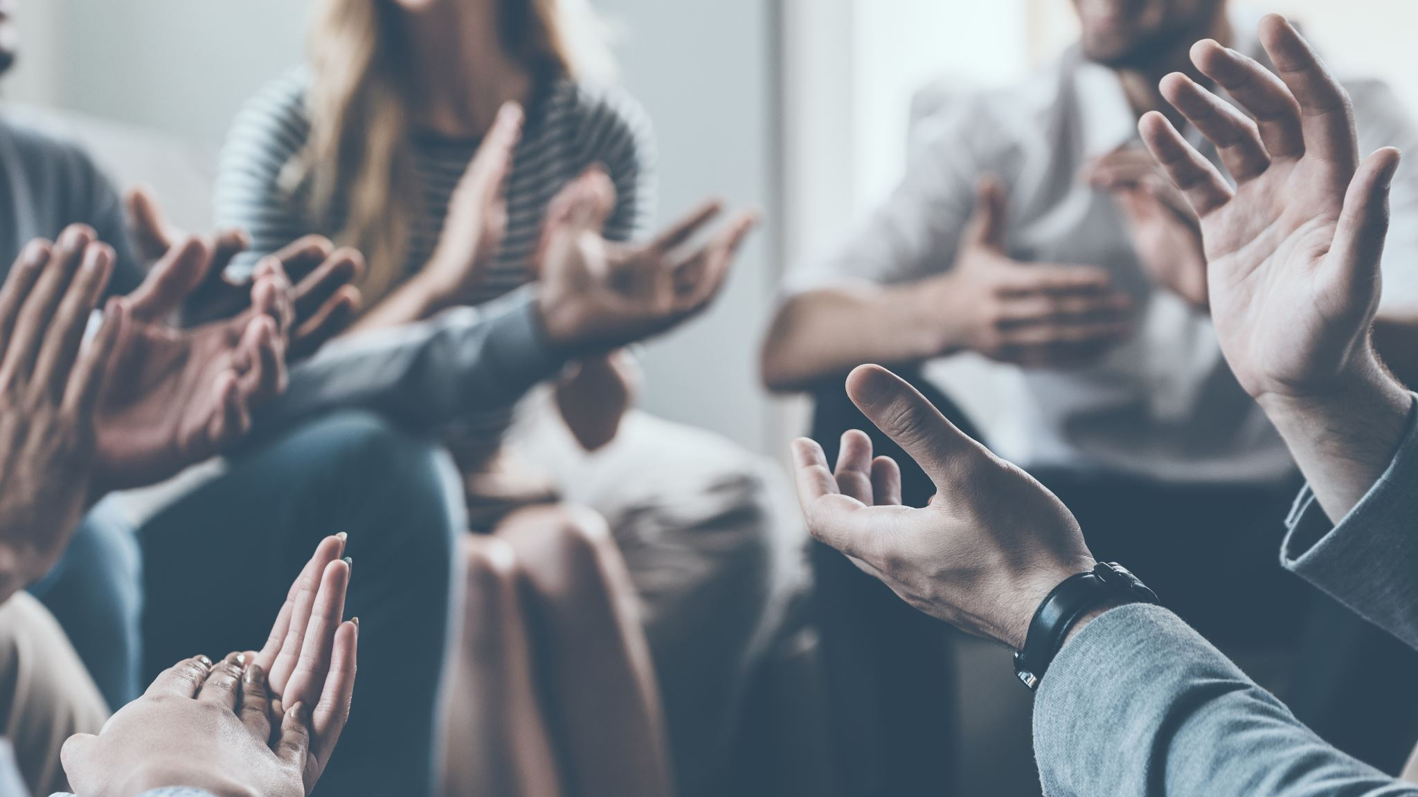
Thank you for listening!

